Slide 1

ICE 3161
COMMUNICATION ENGINEERING
Dr. Asif Zaman
Professor, CSE, RU

Slide 2
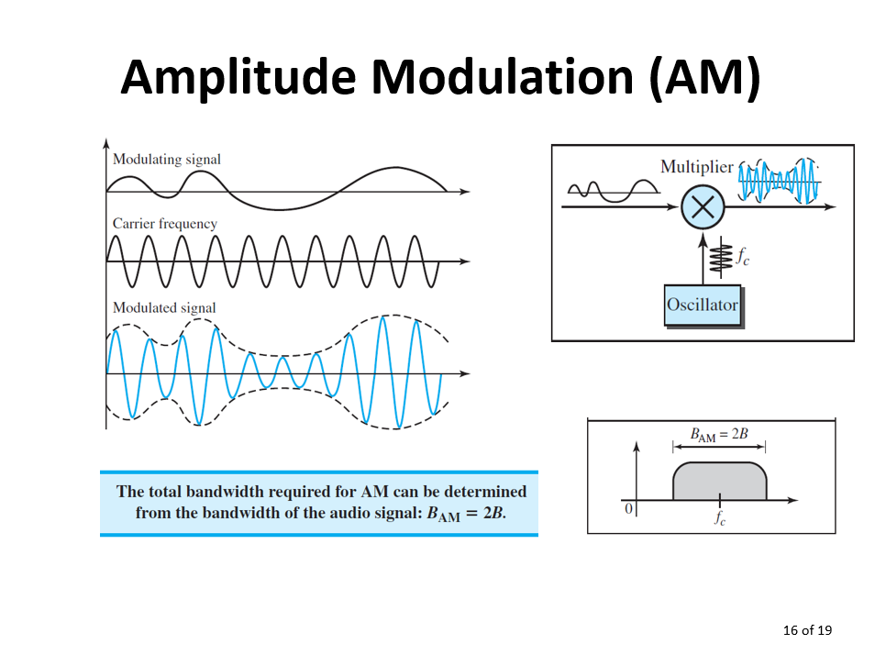
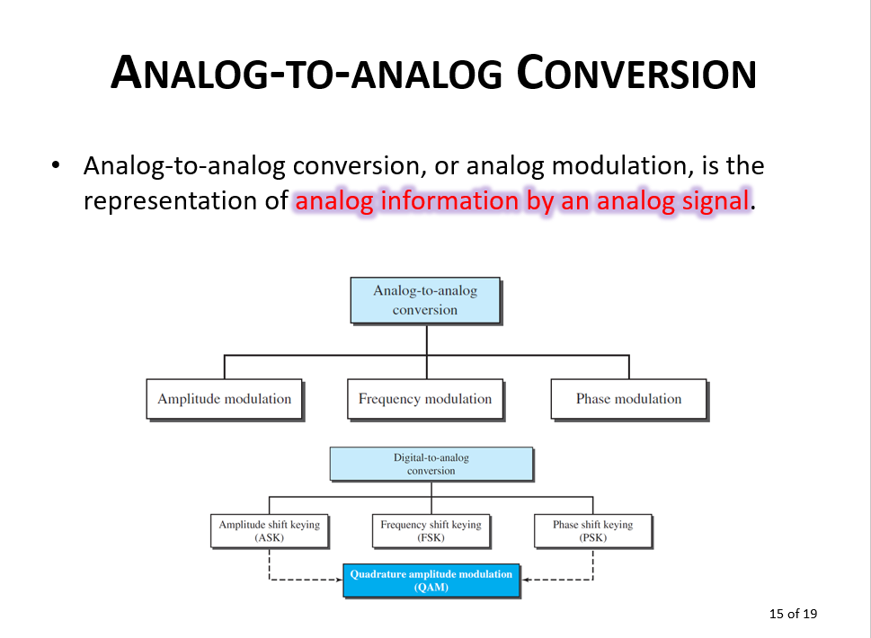
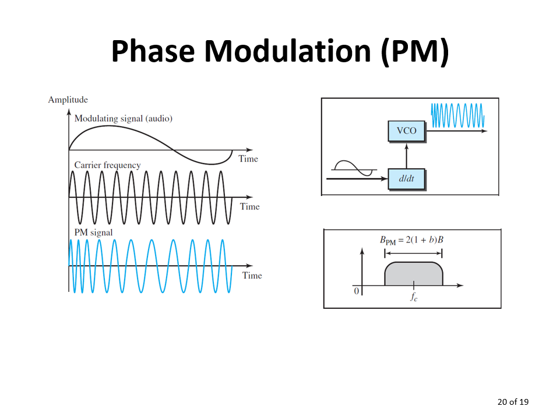
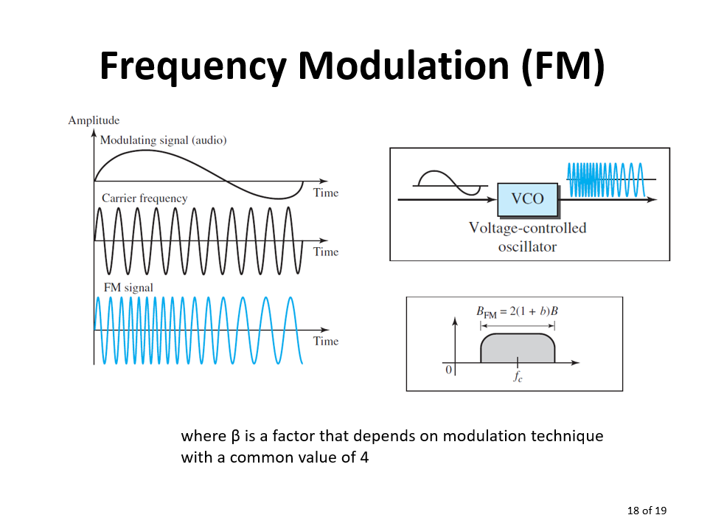

Slide 3
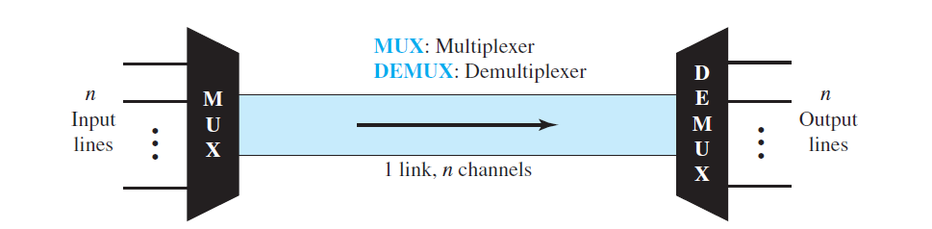
Multiplexing
Multiplexing is the set of techniques that allow the simultaneous transmission of multiple signals across a single data link.
In a multiplexed system,
  n lines share the bandwidth of one link.
  The word link refers to the physical path.
  The word channel refers to the portion of a link that carries a transmission between a given pair of lines.
  One link can have many (n) channels

Slide 4
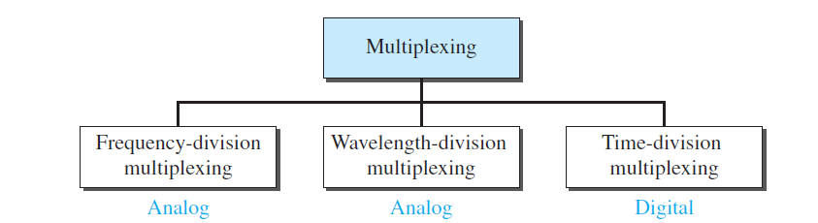
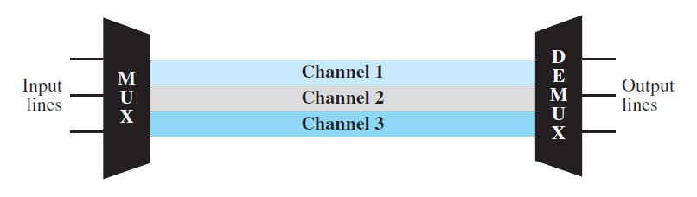
Frequency-Division Multiplexing:
FDM is an analog technique that can be applied when the bandwidth of a link (in hertz) is greater than the combined bandwidths of the signals to be transmitted.

Slide 5
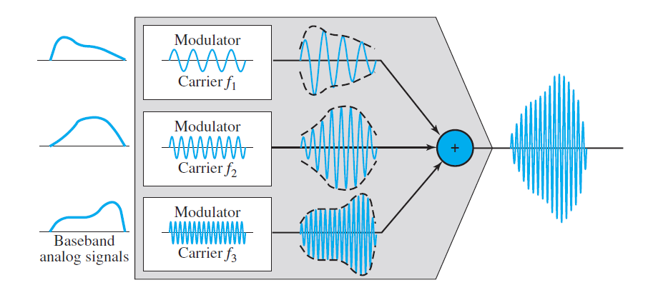
Each source generates a signal of a similar frequency range.
Inside the multiplexer, these similar signals modulate different carrier frequencies ( f1, f2, and f3).
The resulting modulated signals are then combined into a single composite signal that is sent out over a media link that has enough bandwidth to accommodate it.

Slide 6
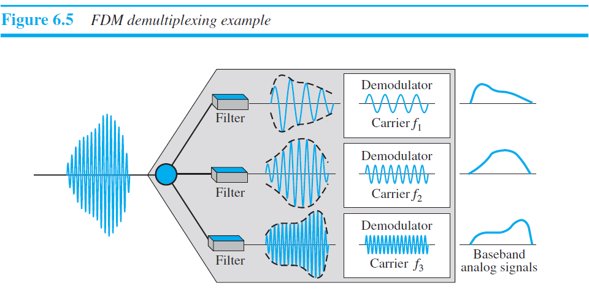
The demultiplexer uses a series of filters to decompose the multiplexed signal into its constituent component signals.
The individual signals are then passed to a demodulator that separates them from their carriers and passes them to the output lines.

Slide 7
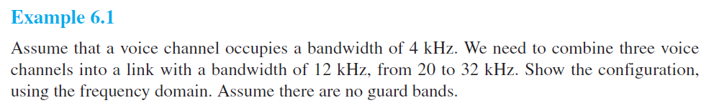
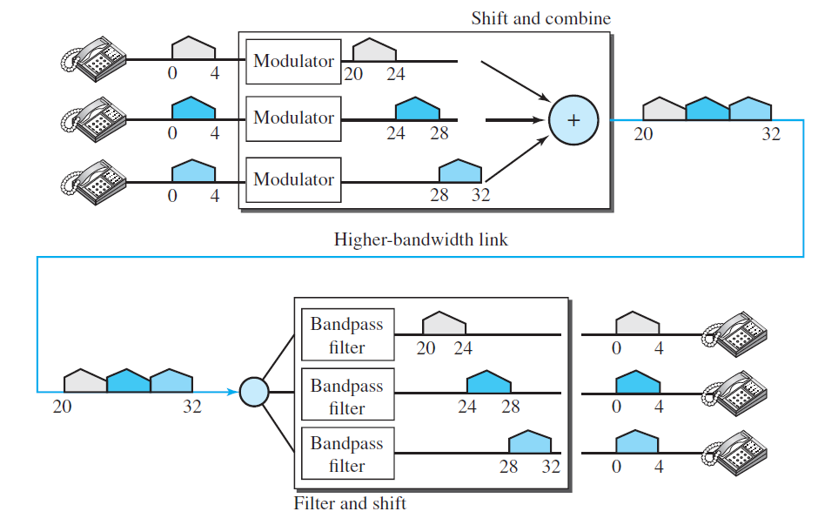

Slide 8
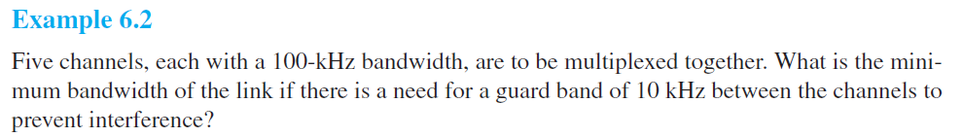
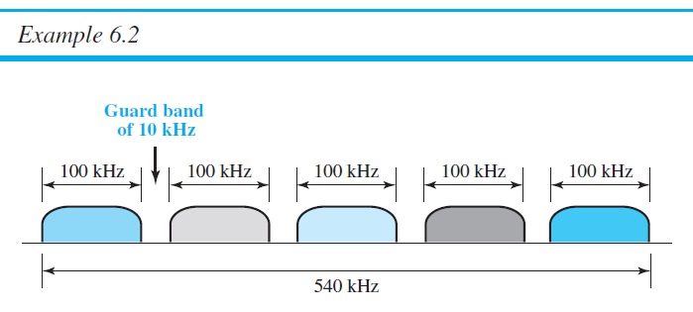

Slide 9
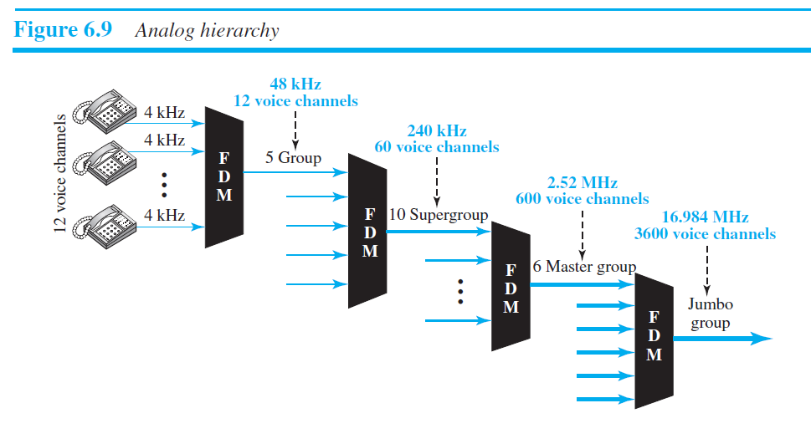
The Analog Carrier System

Slide 10
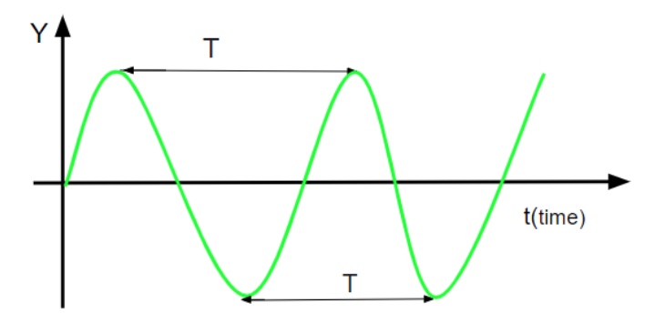
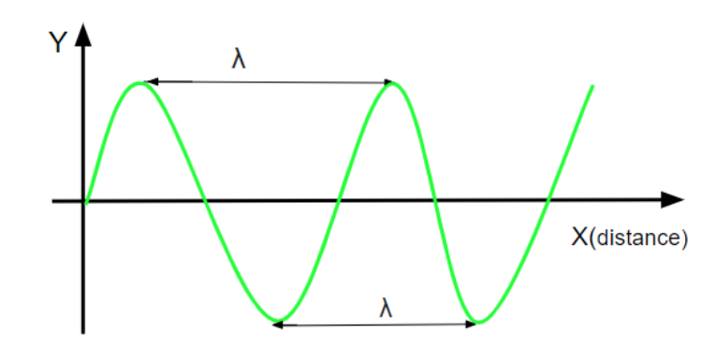
Wavelength-Division Multiplexing

Slide 11
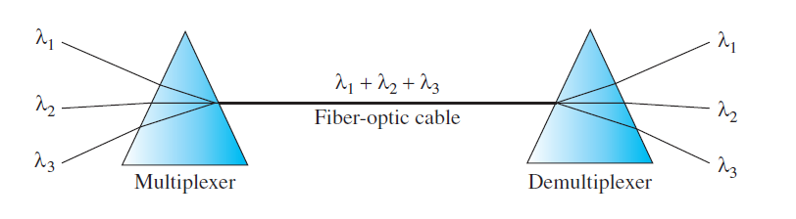
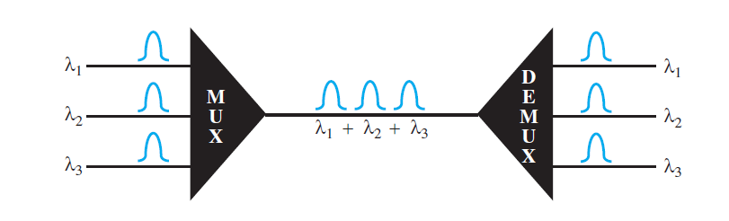
Wavelength-Division Multiplexing

Slide 12
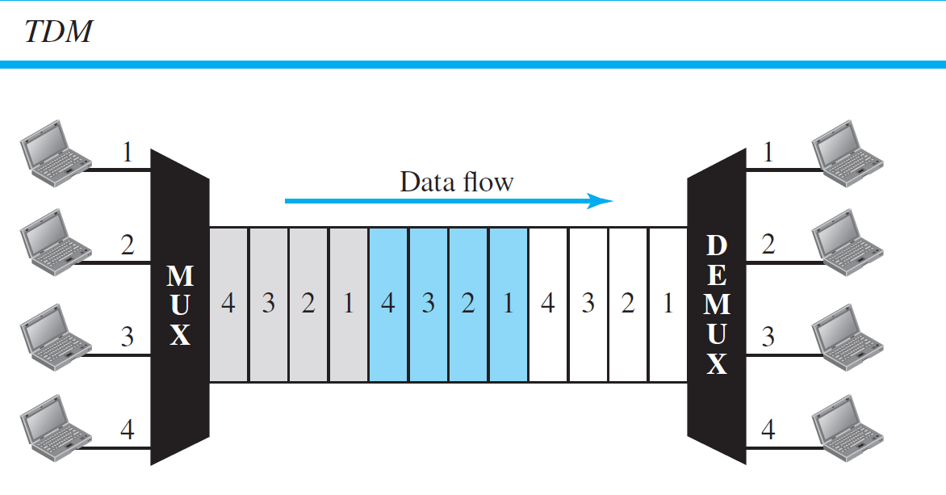
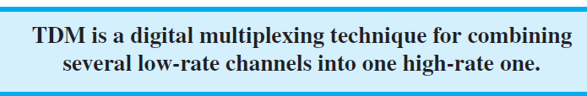
Time-Division Multiplexing (TDM)

Slide 13
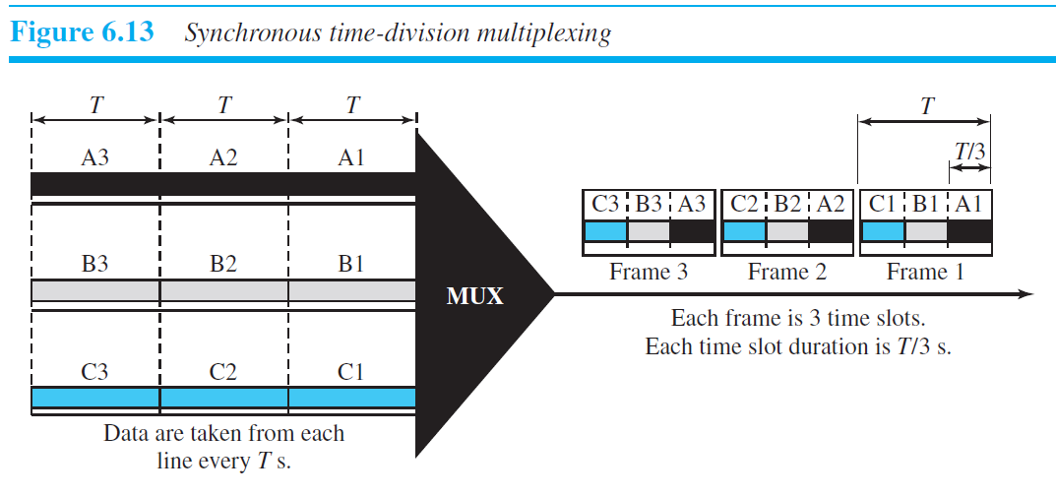
Time-Division Multiplexing (TDM)
We can divide TDM into two different schemes:
  synchronous and
  statistical

Slide 14
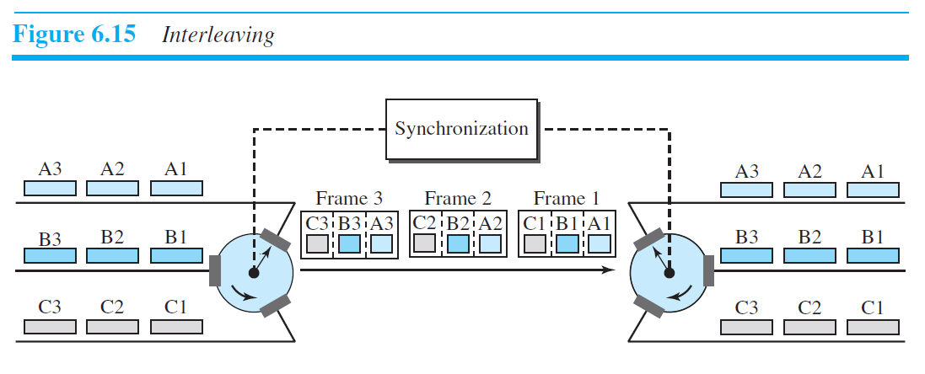
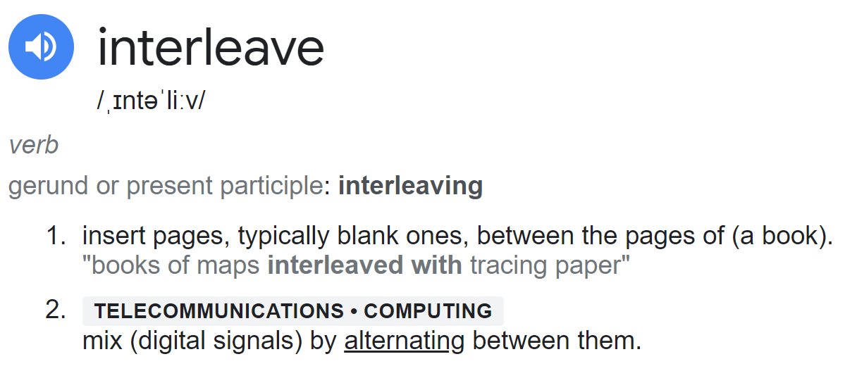

Slide 15
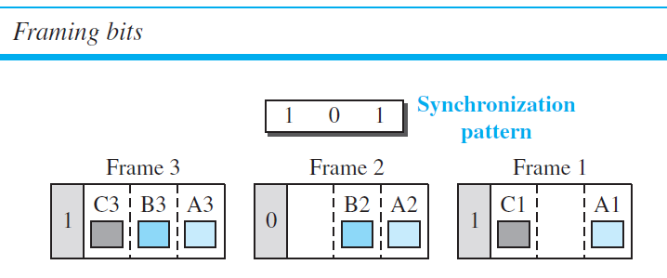
Time-Division Multiplexing (TDM)
Frame Synchronizing

Slide 16
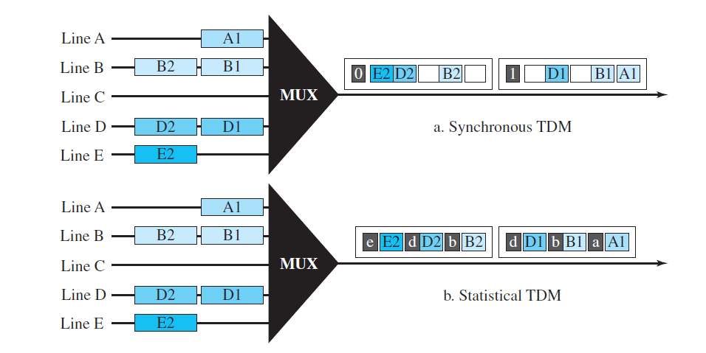
Statistical TDM

Slide 17
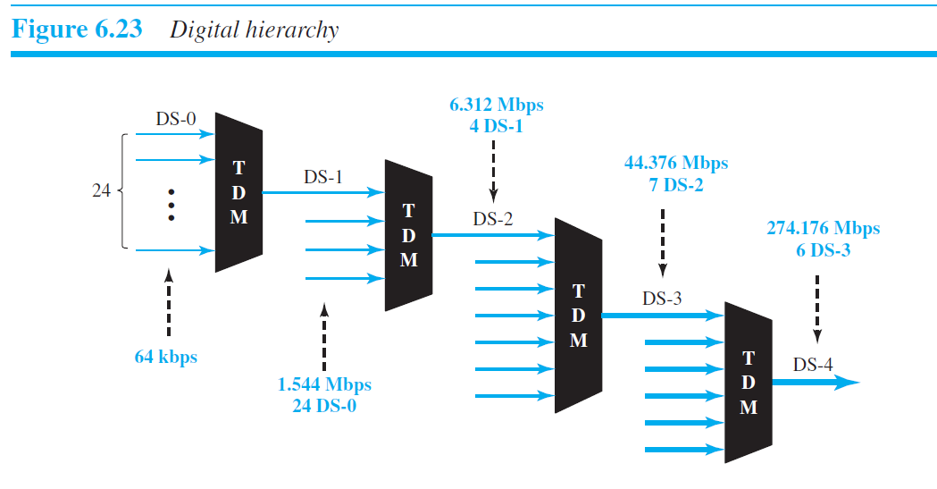
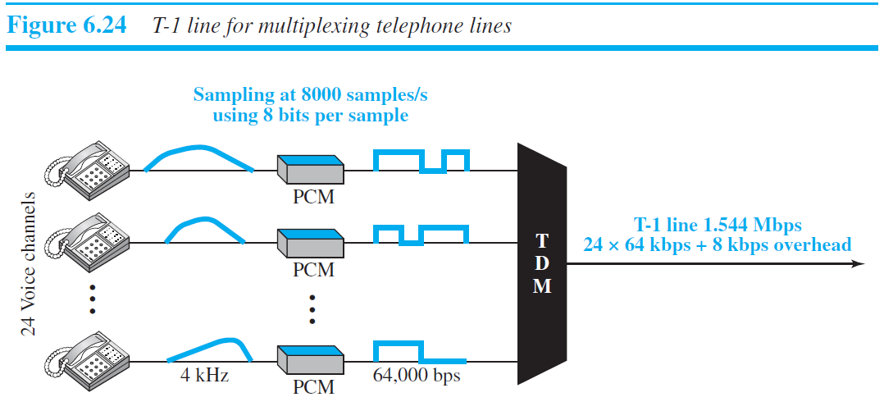
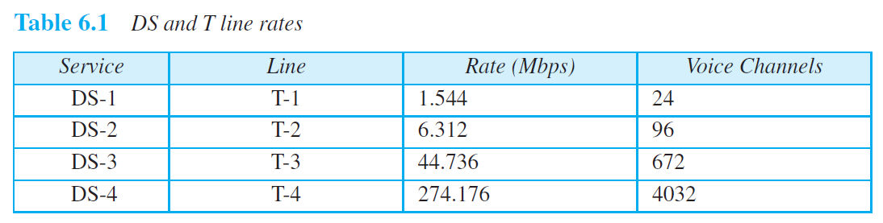
Digital Signal Service

Slide 18
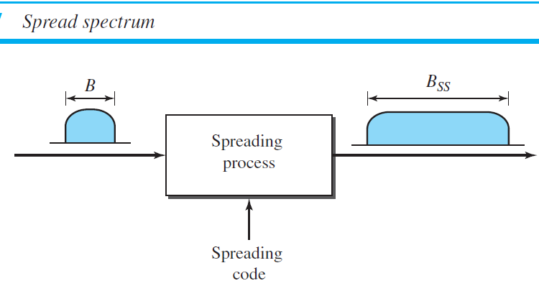
Spread Spectrum
Multiplexing combines signals from several sources to achieve bandwidth efficiency; the available bandwidth of a link is divided between the sources
There are two techniques to spread the bandwidth:
frequency hopping spread spectrum (FHSS) and
direct sequence spread spectrum (DSSS).
Notes:
Hopping → Jumping

Slide 19
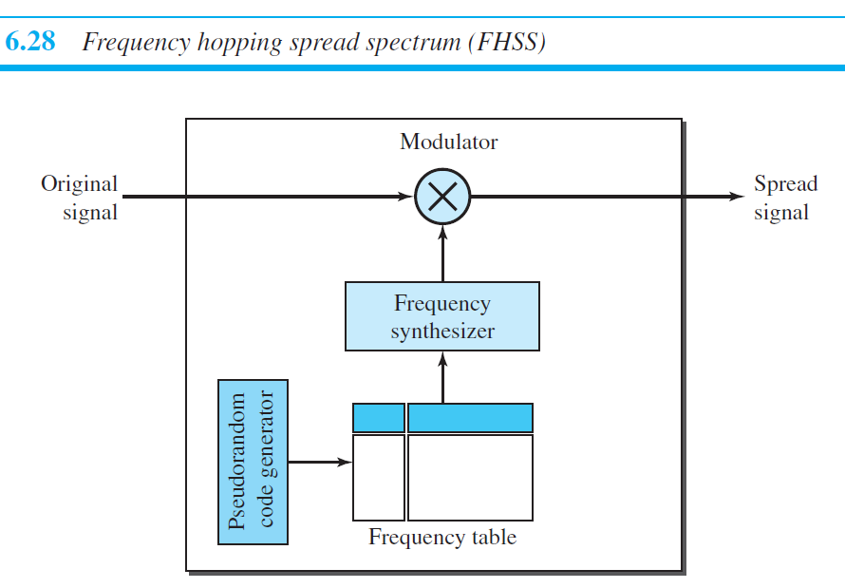
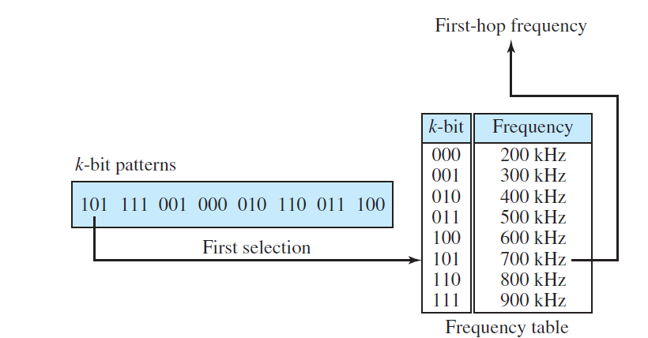

Slide 20
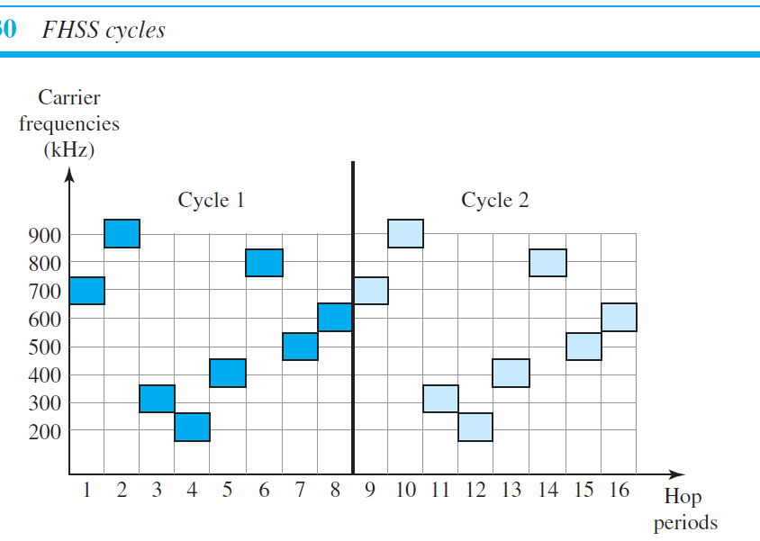
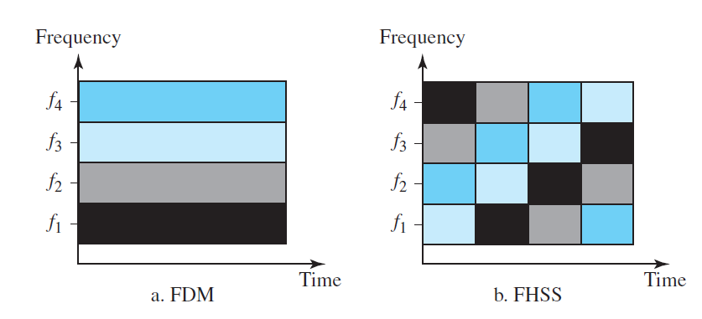

Slide 21
